Slide 1
Python library

Slide 2
CONTENTS
FILE HANDILING | Open, read, and write text files
USING LIBRARY | Math library and random library
NUMPY | Ndarray, reshape, dot product, concatenate, split, useful methods
For more info: SLIDESGO | SLIDESGO SCHOOL | FAQs
You can visit our sister projects: FREEPIK | FLATICON | STORYSET | WEPIK | VIDEVO

Slide 3

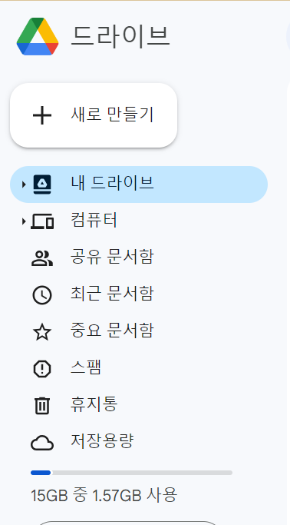
FILE HANDLING
Make a folder and hello.txt.

Slide 4
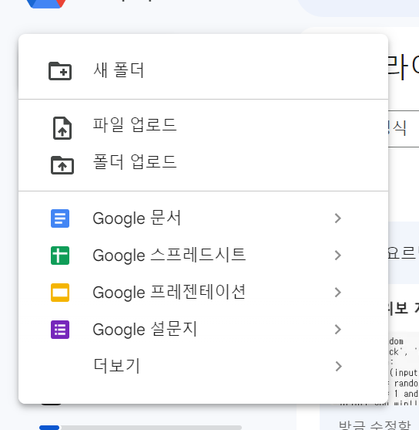
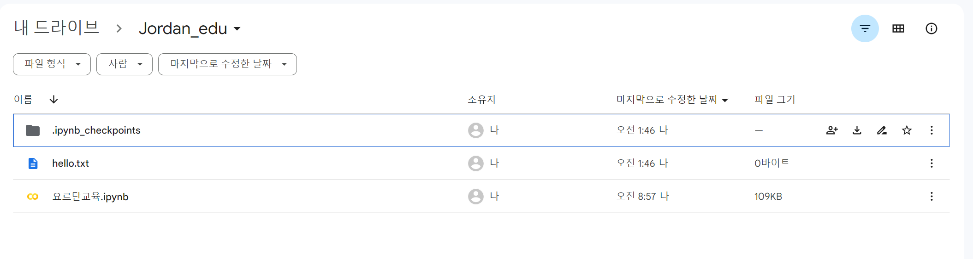
FILE HANDLING
Make a folder and hello.txt.

Slide 5
FILE HANDLING
We can open, read, and write files with python.
First, to open files, we use open() or with … as …
f = open(file_path, mode) Ex) f = open(“hello.txt”, “r”) | open() opens the file in the file_path and return a file stream with the mode.
f.close() | close() closes the file.
with open(file_path, mode) as f: (BLOCK) | with opens the file and automatically closes the file at the end of the block.

Slide 6
FILE HANDLING
There are some modes to open files: “r”, “w”, “a”, “x”, “t”, and “b”
“r” | open the file to “read”
“w” | open the file to “write” (if there exists a file, it functions as “insert”. If not, it makes a new file)
“a” | open the file to “add” (if there exists a file, it add new contents. If not, it makes a new file with “w” mode)
“x” | open the file to “write” (if there exists a file, it makes an error. If not, it makes a new file with “w” mode)
“t” | open the file with “text mode”
“b” | open the file with “binary mode”, which is like image files

Slide 7
FILE HANDLING
Second, to write, we use write() method and writelines() method.
write() method receives a string.
writelines() method receives several strings in a form of list.
f.write(“hello”) | Writes “hello” in the file f.
f.writelines([‘a’,’b’,’k’]) | Writes ‘abk’ in the file f. each argument is written without ‘\n’.

Slide 8
FILE HANDLING
Third, to read, we use read(), readline(), readlines(), seek(), and tell() methods.
f.read(3) | Read string of sizes of 3 and return the string.
f.readline() | Read the file until it meets ‘\n’ and return string.
f.readlines() | Read all strings in the file and return them in the form of list.
f.seek(n) | Move a cursor to n-th position.
f.tell() | Return current position of a cursor.

Slide 9


USING LIBRARY
Now, we are dealing with math module, random module, numpy library, and pandas library.
But what are module and library?
Module : a python file which do a specific function.
Library : a collection of modules.

Slide 10
USING LIBRARY
To use math module, we must import math module. We want to use pow and sqrt function.
There are several ways to use modules.
1
import math | import math library
math.pow(2,4) | use pow function in math module.
math.sqrt(5) | use sqrt function in math module.
2
import math as m | Import math library as the name m
m.pow(2,4) | use pow function in math module
m.sqrt(5) | use sqrt function in math module

Slide 11
USING LIBRARY
To use math module, we must import math module. We want to use pow and sqrt functions.
There are several ways to use modules.
3
from math import pow, sqrt | Import pow and sqrt from math module
pow(2,4) | use pow function in math module.
sqrt(5) | use sqrt function in math module.
4
from math import pow as p, sqrt as s | Import pow and sqrt as the name p and s, respectively, from math module
p(2,4) | use pow function in math module
s(5) | use sqrt function in math module

Slide 12

Lab
Now, try printing square root of input data. (data type is int)

Slide 13
USING LIBRARY
Let’s use random(), uniform(), randint(), randrange(), choice(), shuffle() from random module
Import random | import random module
random.random() | Return random float between 0 and 1
random.uniform(2,4) | Return random float between 2 and 4
random.randint(2,4) | Return random integer from 2 to 4
random.randrange(1,7,1) | Return random integer in the list of integers between 1 and 7 by 1 step
random.choice(seq) | Return random argument from seq(list, tuple, string)
random.shuffle(seq) | Shuffle randomly the seq

Slide 14
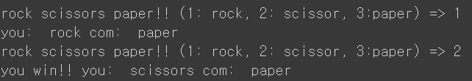
USING LIBRARY
Now, try making rock scissors paper game!
Hint: use random module

Slide 15
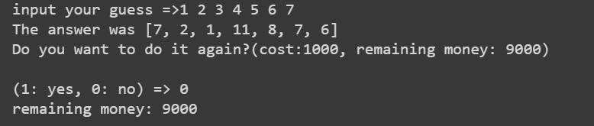
USING LIBRARY
Now, try making a lottery machine!

Slide 16
numpy
Let’s move on to numpy library, which is for vector and matrix operation.
In this chapter, we deal with ndarray, reshape, dot product, concatenate, split, and other useful methods
ndarray is an n-dimensional matrix data structure of Numpy.
a = np.array([[0,1,2], [3,4,5]]) | Make 2 by 3 matrix
a[0,0] | Reference to 0 row and 0 column in a
a[0,:] | Reference to 0 row and all columns in a
a[0, 0:2] | Reference t o 0 row and columns from 0 to 2 in a
b = np.array([0,1,2]) * 10 idx1 = np.array([True, False, True]) print(b[idx1]) | Multiply 10 to each argument in b Print arguments of index of True
c = np.array([0,1,2,3,4,5,6,7])*10 idx2 = np.array([0,2,3,3,6]) print(c[idx2]) | Print arguments of index of index2.

Slide 17
numpy
numpy.concatenate() merges ndarrays.
a = a.reshape((3,2)) print(a) | reshape a(2 by 3 matrix) to 3 by 2 matrix
d = np.array([[1,2],[3,4],[5,6]]) a_Y = numpy.concatenate((a,d), axis=0) a_X = numpy.concatenate((a,d), axis=1) | concatenate function merge ndarrays. axis = 0 => merge vertically axis = 1 => merge horizontally

Slide 18
numpy
And numpy.split() splits ndarray.
e = numpy.array([[1,2,3],[5,6,7],[8,9,10], [11,12,13]]) slice_Y_equal_size = np.split(e, 2, axis = 0) print(slice_Y_equal_size) | numpy.split(ndarray, N, axis = 0 or 1) splits ndarray vertically(axis = 0) or horizontally(axis = 1) into N ndarrays with the same sizes
slice_Y_different_size = np.split(e, [2,3],axis=0) | numpy.split(ndarray, List, axis = 0 or 1) splits ndarray vertically or horizontally into several ndarrays at the position of arguments of List
N = 2, axis = 0
List = [2,3] , axis = 0
1 | 2 | 3
5 | 6 | 7
8 | 9 | 10
11 | 12 | 13
1 | 2 | 3
5 | 6 | 7
8 | 9 | 10
11 | 12 | 13

Slide 19
numpy
Other useful methods: sum, max, min, mean, std
numpy.sum(a, axis = 1) | Get sum of elements in a which are on axis of 1
numpy.max(a) | Get max among elements in a
Numpy.min(a) | Get min among elements in a
Numpy.mean(a) | Get mean of elements in a
Numpy.std(a) | Get standard deviation of elements in a

Slide 20
Lab-use numpy.dot()
Now, use numpy.dot()

Slide 21
Lab-use numpy.dot()
1.make a 1D ndarray A and B. A is [1,2,3,4,5,6] and B is [11,12,13,14,15,16]
2.make a 3 by 2 matrix from A and a 2 by 3 matrix from B
3.do dot product between the two matrixes (Hint: numpy.dot(matrix1, matrix2))

Slide 22
Lab-use numpy methods
Now, use numpy methods

Slide 23

Lab-use numpy methods
1.make matrix A like this =>
2.make 6 by 2 matrix B which is a result of A.reshape
3.split B vertically and store the top as C and the bottom as D
4.make a matrix E by merging C and D horizontally

Slide 24
THANKS
Do you have any questions?
im.hongeun@gm.gist.ac.kr

